Slide 1


Signal Preprocessing And Estimation of
The Heart Rate and Respiration Rate
From PPG without AI
Rafsan Jany
Korean Convergence Medical Science

Slide 2
NONAi Methods RGB Dataset
Heart Rate Estimation
Study - 1
Algorithm:
ICA + FFT
Paper:
Non-contact, automated cardiac pulse measurements using video imaging and blind source separation.
Dataset: Custom Dataset FPS 15, 12 Subjects, 1 min Duration
Before ICA:
RMSE: 6.00 bpm
After ICA:
RMSE: 2.29 bpm
Citation:
Poh MZ, McDuff DJ, Picard RW. Non-contact, automated cardiac pulse measurements using video imaging and blind source separation. Opt Express. 2010 May 10;18(10):10762-74. doi: 10.1364/OE.18.010762. PMID: 20588929.

Slide 3
Algorithm Flow
Video Input
Face Detection (MediaPipe)
ROI: Full Face Bounding Box
Frame-wise Mean RGB Signal
Sliding Window (20s)
Detrending + Normalization
ICA Decomposition (3 components)
Automated IC Selection (Scoring: peaks, RR std, etc.)
Manual IC Selection (Visual Inspection)
Peak Detection in Time Domain
Apply FFT to Selected IC
Apply FFT to Selected IC
Compute RR Intervals
Find Max Power Frequency in 0.75–4 Hz
Find Max Power Frequency in 0.75–4 Hz
HR = 60 / mean(RR)
HR = max_freq × 60
HR = max_freq × 60
Compare with Ground Truth

Slide 4
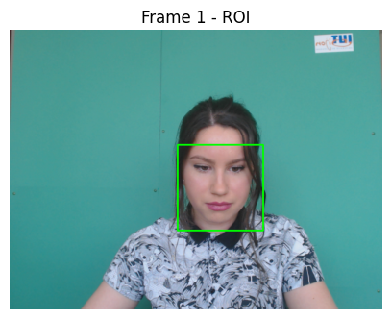
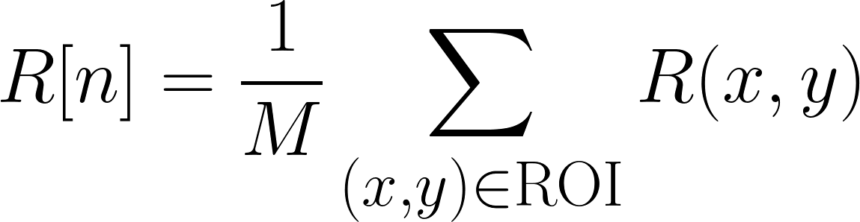
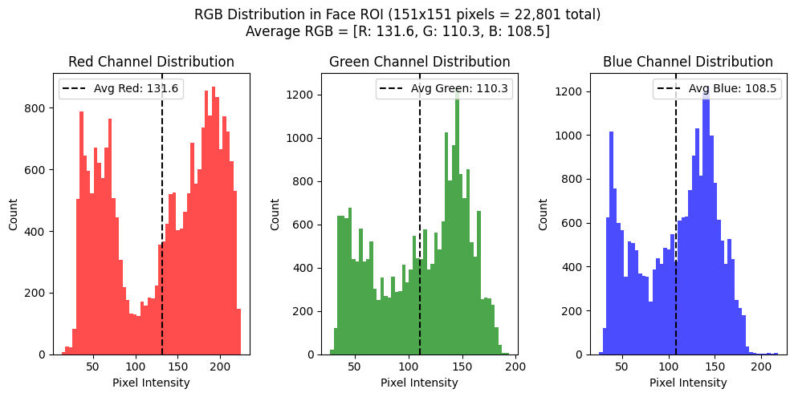
HR Study 1: Applied on UBFC Dataset
Step 1: Extract RGB Signals from Face ROI (UBFC Dataset)
Use the whole face for simplicity and stability
For each frame:
Detailed ROI RGB Values for First 5 Frames out of of 1547 Frames:
Frame ROI Shape(HxW) ROI Pixels Sample (BGR) R Mean G Mean B Mean
1 147x147 [(87, 96, 62), (65, 74, 40), (50, 53, 44), (46, 49, 40)..] 130.35 107.94 106.82
2 148x148 [(128, 134, 77), (115, 121, 64), (86, 92, 54), (69, 75, 37)..] 129.61 107.40 106.46
3 147x147 [(115, 119, 60), (85, 93, 55), (66, 74, 36), (51, 54, 45)..] 130.20 107.65 106.67
4 147x147 [(115, 119, 60), (85, 92, 58), (65, 72, 38), (50, 54, 42)..] 130.17 107.68 106.66
5 147x147 [(112, 119, 58), (91, 95, 57), (71, 75, 37), (44, 49, 35)..] 130.27 107.66 106.65

Slide 5
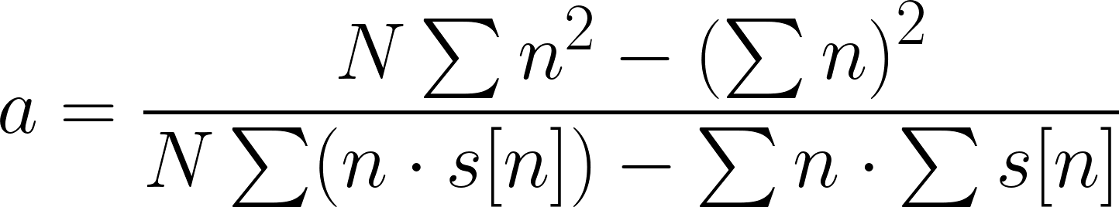
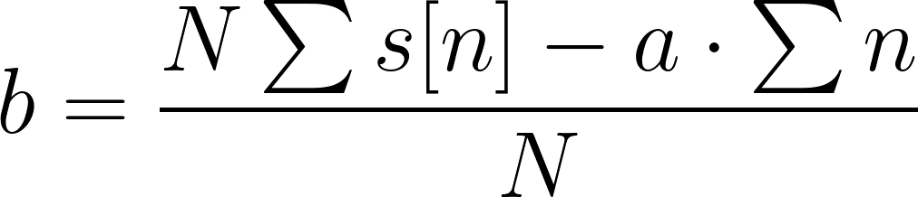
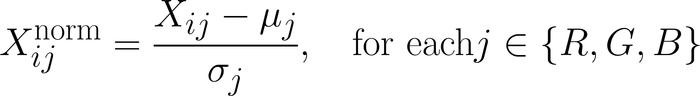
HR Study 1: Applied on UBFC Dataset
Step 2: Detrending + Normalize (Standardization)
2.1 Detrending:
Removes slow-changing trends from R, G, B (e.g., lighting changes, camera gain)
Mathematically:
X ′ =X−best linear fit(X)
Line for best linear fit, 𝑦 = 𝑎⋅𝑛 + 𝑏
2.2 Normalize (Standardization):
For each of R, G, B signals:
Subtract the mean → zero-centered
Divide by standard deviation → unit variance
Mathematically:
scipy.signal.detrend
numpy.polyfit
First 5 Normalized RGB Values:
R G B
Frame 1 -1.8766 -1.0660 -1.7588
Frame 2 -2.3272 -1.7745 -2.3094
Frame 3 -1.9684 -1.4424 -1.9855
Frame 4 -1.9829 -1.4007 -1.9868
Frame 5 -1.9207 -1.4246 -2.0051

Slide 6
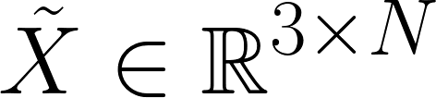
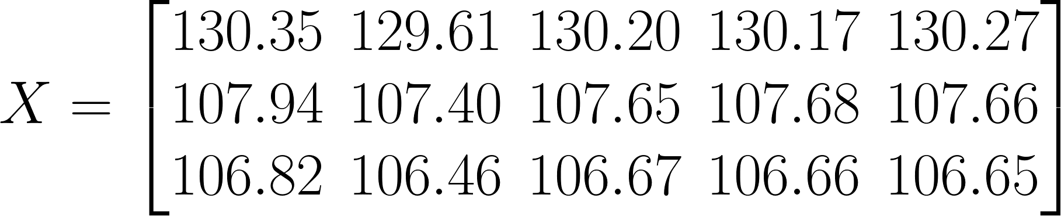
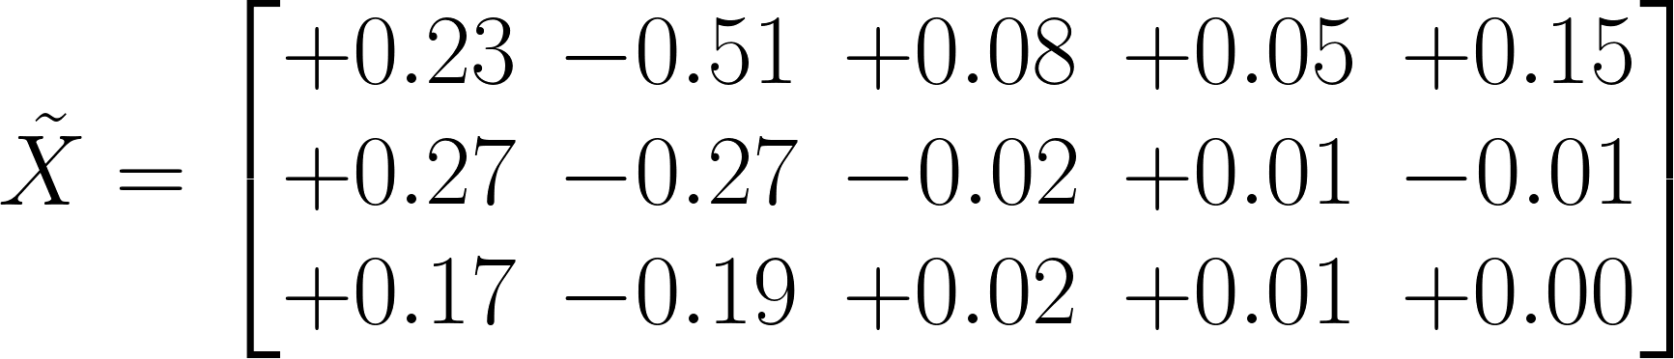
HR Study 1: Applied on UBFC Dataset
Step 3.1: Centered matrix
Extracted mean RGB values over 5 frames
Frame | R centered | G centered | B centered
1 | 130.35 - 130.12 = +0.23 | 107.94 - 107.67 = +0.27 | 106.82 - 106.65 = +0.17
2 | 129.61 - 130.12 = -0.51 | 107.40 - 107.67 = -0.27 | 106.46 - 106.65 = -0.19
3 | 130.20 - 130.12 = +0.08 | 107.65 - 107.67 = -0.02 | 106.67 - 106.65 = +0.02
4 | 130.17 - 130.12 = +0.05 | 107.68 - 107.67 = +0.01 | 106.66 - 106.65 = +0.01
5 | 130.27 - 130.12 = +0.15 | 107.66 - 107.67 = -0.01 | 106.65 - 106.65 = 0.00

Slide 7
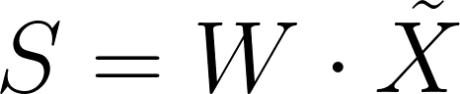
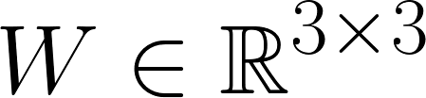
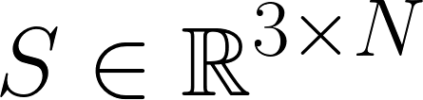
HR Study 1: Applied on UBFC Dataset
Step 3.2: ICA Decomposition
ICA assumes that observed signals are linear mixtures of unknown, statistically independent source signals.
Input Matrix
ICA tries to find a matrix 𝑊 such that:
ICA tries to find a matrix 𝑊 such that:
Where:
: centered matrix
: unmixing matrix
: independent components
Ideally, one IC corresponds to the pulse signal
Can’t Manually Compute ICA
ICA is an iterative optimization algorithm.
Using algorithms like FastICA from sklearn.decomposition
Independent Components (S matrix) | Unmixing matrix (W matrix)
[[3.9890795970422315, 2.925790681403517, 2.955... | [[-0.982439364715348, 5.946033311414262, -4.91...
[[0.5027940166419597, 0.268948407522373, 0.215... | [[-0.754977830461565, -1.4200691202604538, 3.1...
[[0.47665347450543394, 1.0389063369947562, 0.6... | [[-2.14635011245277, -3.609849424800457, 5.197...
[[0.7334066589293606, 0.05180511490808828, -0.... | [[-2.2295616479395477, -3.0966900334553973, 4....
[[-3.796829078439223, -4.680106206973313, -4.2... | [[-1.573003397772687, -3.8411297767670898, 4.7...
[[-0.017394728336645446, -0.46479776531853667,... | [[-3.03171420520726, -5.0036973702376475, 6.32...
[[-1.2934735084933515, -1.3078702482878097, -1... | [[-1.6407684820541586, 7.325181903737755, -5.3...

Slide 8
HR Study 1 Modification: Applied on UBFC Dataset
Step 3.3: Selecting ICA
Automation
Use a scoring function that combines:
valid_HR_score
rr_std_score
band_power_score
autocorrelation_score
Peak detection
2. RR interval regularity (lower std is better)
3. Bandpower in 0.7–2.5 Hz
(typical heart rate range)
4. Autocorrelation peak in ~1Hz region
5. Combined score
(weights tuned based on signal behavior)
This method is recommended in follow-up studies (eg McDuff 2014, CHROM++, POS++, LiCVPR).
Visual Inspection (In Study)
They looked for the ICA signal that:
Had approximately 1–2 Hz frequency (60–120 bpm)
Showed a regular, smooth waveform
Wasn't noisy, erratic, or flat

Slide 9
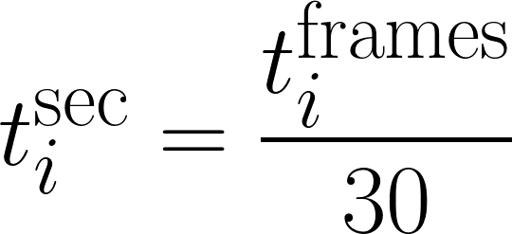
HR Study 1 Modification: Applied on UBFC Dataset
Step 3.4: Calculating HR With Automation
Assuming:
Window 1 = frames 0 to 599
IC 1 was chosen
Detected 33 peaks
Detected peaks = [t₁, t₂, ..., t₃₃] in frame units
Convert to seconds :
Then compute:
intervals=
Got 32 ​​time intervals (since 33 peaks using find_peaks from scipy.signal).
T = average time between peaks( in seconds )
x[i] is a peak
if x[i-1] < x[i] > x[i+1]

Slide 10
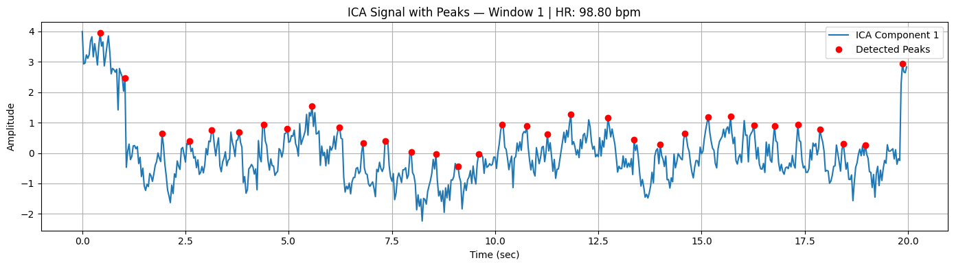
HR Study 1 Modification : Applied on UBFC Dataset
Step 3.1: Calculating HR
Got 32 ​​time intervals (since 33 peaks).
T = average time between peaks( in seconds )
HR(bpm) = 60/ T
If T = 0.607, then HR = 60/0,607 = 98.8 bpm

Slide 11
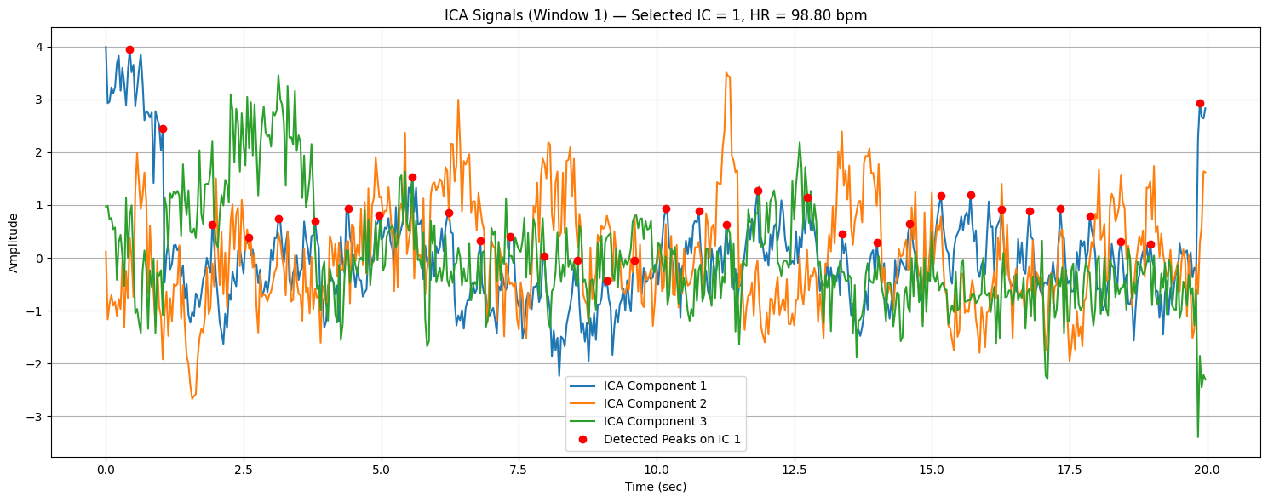
HR Study 1: Applied on UBFC Dataset
Step 3.2: ICA Decomposition in Sliding Window

Slide 12
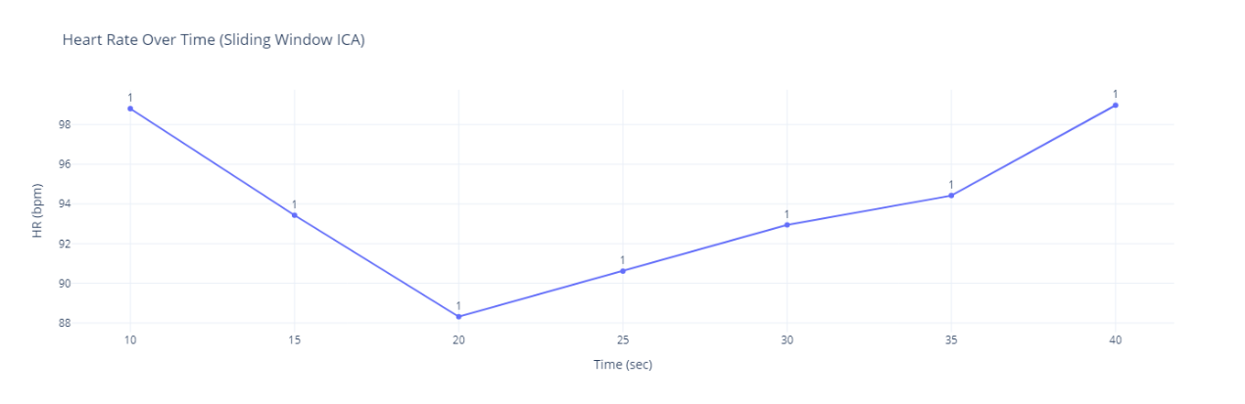
HR Study : Applied on UBFC Dataset
Step 3.2: ICA Decomposition in Sliding Window
fs = 30 # Frames per second
window_size = 600
step_size = 150
num_windows = floor((1547 - 600) / 150) + 1
= floor(947 / 150) + 1
= floor(6.31) + 1
= 6 + 1 = 7 windows
Window | Time (sec) | Estimated HR (bpm) | CA Component | Peak Count | Independent Components (S matrix) | Unmixing matrix (W matrix)
1 | 10.0 | 98.80 | 1 | 33 | [[3.9890795970422315, 2.925790681403517, 2.955... | [[-0.982439364715348, 5.946033311414262, -4.91...
2 | 15 | 93.43 | 1 | 31 | [[0.5027940166419597, 0.268948407522373, 0.215... | [[-0.754977830461565, -1.4200691202604538, 3.1...
3 | 20 | 88.32 | 1 | 30 | [[0.47665347450543394, 1.0389063369947562, 0.6... | [[-2.14635011245277, -3.609849424800457, 5.197...
4 | 25 | 90.62 | 1 | 30 | [[0.7334066589293606, 0.05180511490808828, -0.... | [[-2.2295616479395477, -3.0966900334553973, 4....
5 | 30 | 92.94 | 1 | 31 | [[-3.796829078439223, -4.680106206973313, -4.2... | [[-1.573003397772687, -3.8411297767670898, 4.7...
6 | 25 | 94.42 | 1 | 32 | [[-0.017394728336645446, -0.46479776531853667,... | [[-3.03171420520726, -5.0036973702376475, 6.32...
7 | 40 | 98.97 | 1 | 33 | [[-1.2934735084933515, -1.3078702482878097, -1... | [[-1.6407684820541586, 7.325181903737755, -5.3...

Slide 13
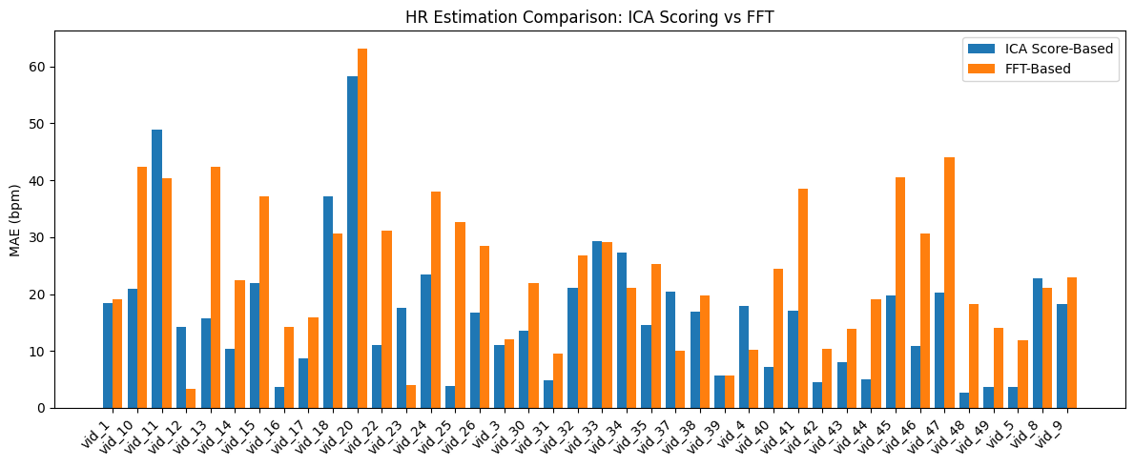
Comparisons: Full Face
For comparisons I have used rfft, rfftfreq from scipy.fft for implementing the core algorithm of the paper.
Apply FFT to Selected IC
Find Max Power Frequency in 0.75–4 Hz
HR = max_freq × 60
Compare with Ground Truth
Average MAE – ICA + Time Domain: 16.43 bpm Average MAE – ICA + FFT : 24.15 bpm

Slide 14
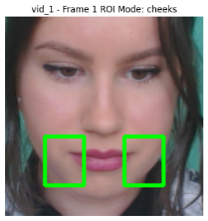
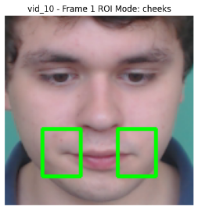
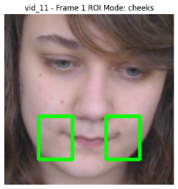
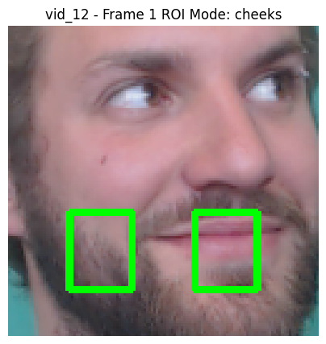
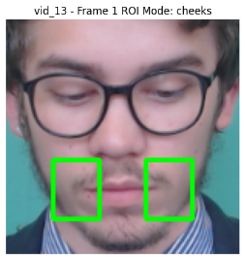
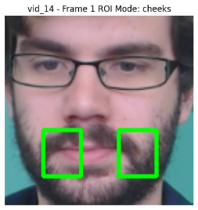
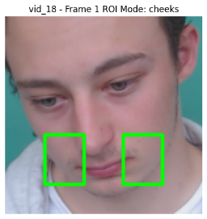
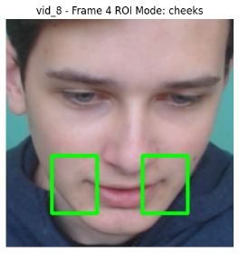
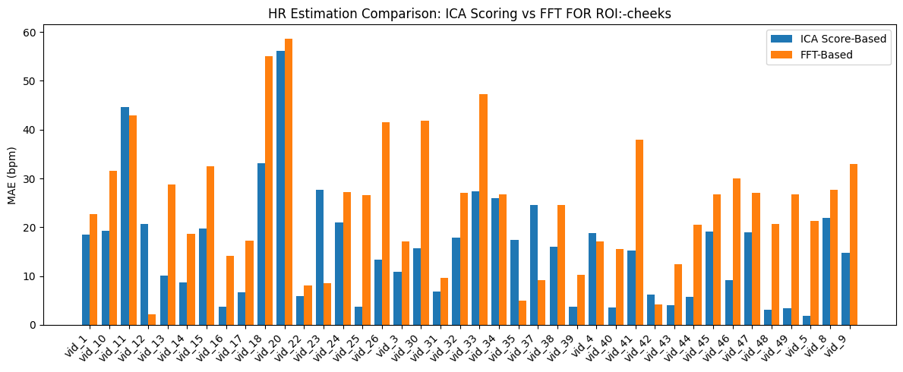
Comparisons: Cheeks
Average MAE – ICA + Time Domain: 15.62 bpm Average MAE – ICA + FFT : 24.39 bpm

Slide 15
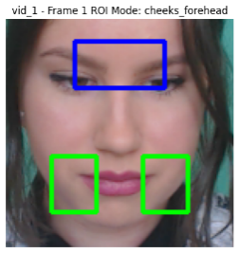
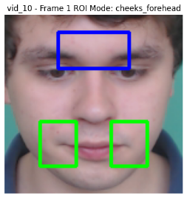
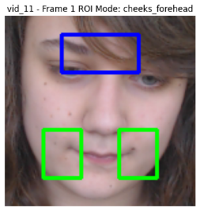
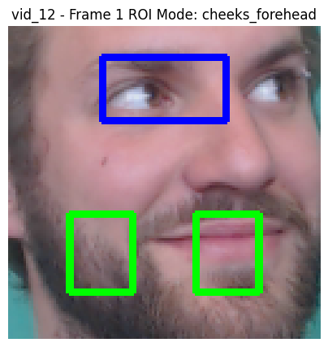
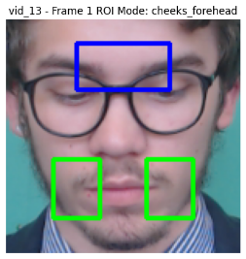
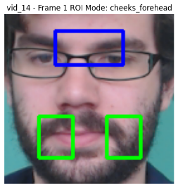
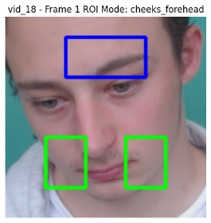
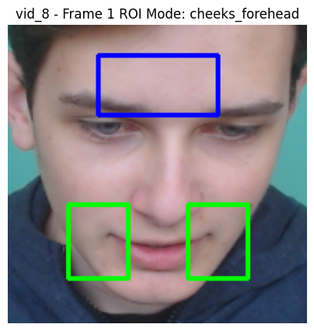
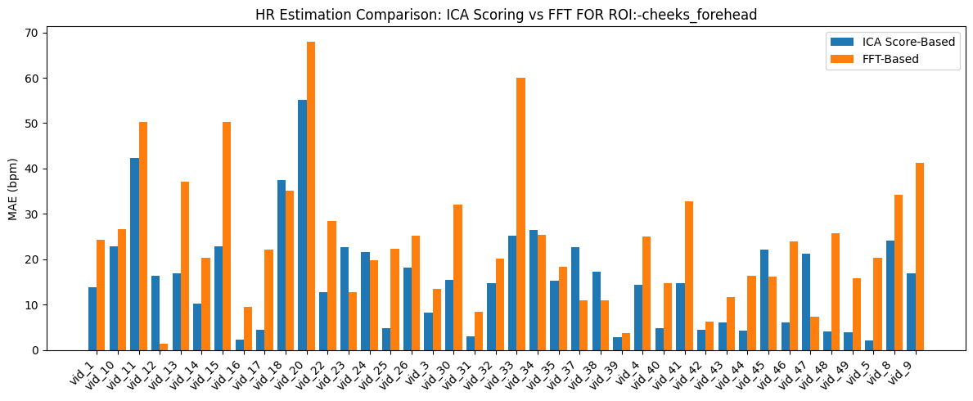
Comparisons: Cheeks+Forhead
Average MAE – ICA + Time Domain: 15.65 bpm Average MAE – ICA + FFT : 23.73 bpm

Slide 16
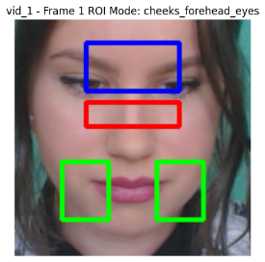
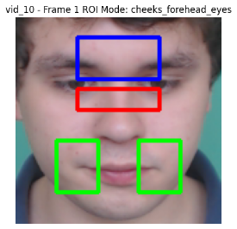
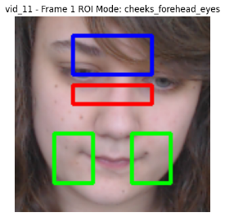
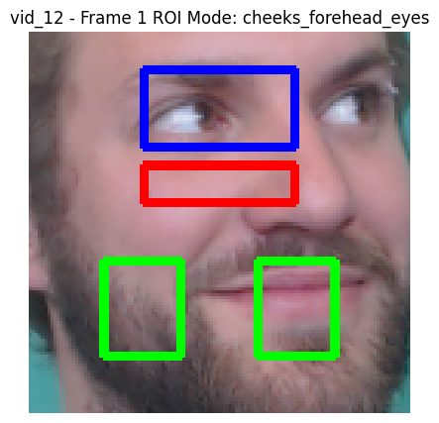
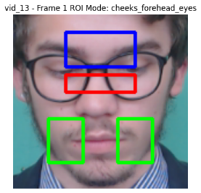
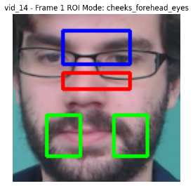
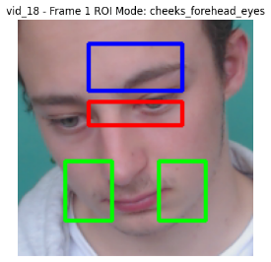
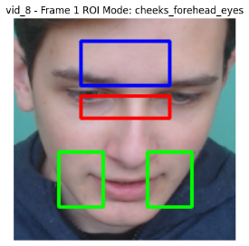
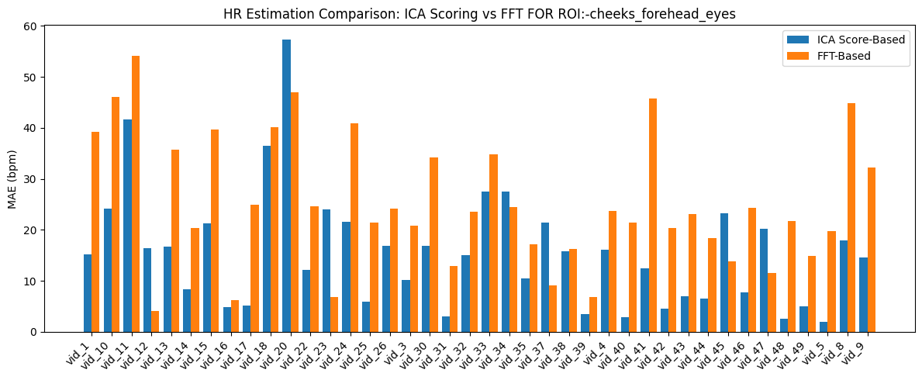
Comparisons: Full Face
Average MAE – ICA + Time Domain: 15.55 bpm Average MAE – ICA + FFT : 24.28 bpm

Slide 17
Time Domain Analysis 1 :
Core Idea:
AMPD (Automatic Multiscale-based Peak Detection) is a technique designed to identify peaks in quasi-periodic signals like PPG. The AMPD algorithm operates by analyzing local maxima across multiple scales to detect
peaks without predefined thresholds.
The algorithm involves:
Signal Detrending: Removing linear trends to stabilize the baseline.
Local Maxima Scalogram Construction: Creating a matrix to identify potential peaks across scales.
Scale Selection: Determining the optimal scale that balances sensitivity and specificity in peak detection.
Peak Identification: Extracting peak positions based on the selected scale.
AMPD detects peaks by measuring their consistency across scales, then selecting those that are stable across all relevant scales — without any tuning.
Time Domain Analysis
Study - 1
Algorithm:
Automatic Multiscale-based Peak Detection (AMPD)
Paper:
An Efficient Algorithm for Automatic Peak Detection in Noisy Periodic and Quasi-Periodic Signals
Dataset: Multiple Signal Data
Citation:
Scholkmann, F.; Boss, J.; Wolf, M. An Efficient Algorithm for Automatic Peak Detection in Noisy Periodic and Quasi-Periodic Signals. Algorithms 2012, 5, 588-603. https://doi.org/10.3390/a5040588

Slide 18
Time Domain Analysis 1: Applied on
Dataset Type | Description | Signal Details | Results
Simulated – Type A (Custom) | Periodic sinusoidal signals with Gaussian white noise | Frequency: 1 Hz Sampling rate: 100 Hz Duration: 20 s - SNR: 0–25 dB | All peaks correctly detected across all noise levels
Simulated – Type B(Custom) | Quasi-periodic chirp signals | Frequency sweep: 1–3.8 Hz - Same SNR levels as Type A | All peaks correctly detected across all noise levels
Sunspot Numbers (Link) | Monthly total number of sunspots (1749–2011) | - 3151 data points | 23 peaks detected No false positives
Blood Volume Pulse (fNIRS) (Link) | BVP-related oscillation in [O₂Hb] signal | Sampling rate: 10 Hz - Duration: 200 s | 225 peaks detected No false positives
CO₂ Concentration (Link) | End-tidal CO₂ waveform (PETCO₂) | Sampling rate: 5 Hz Duration: 500 s | 133 peaks detected No false positives
ECG (QRS Detection) (Link) | Electrocardiogram signal (R-peaks) | Sampling rate: 128 Hz Duration: 200 s | 221 R-peaks detected No false positives
Earth’s Length of Day (LOD) (Link) | Daily variation due to lunar tidal forcing | - Duration: 2008–2011 (1461 days) | 105 peaks detected 1 missed (false negative) No false positives
Lorenz System (Chaos) (Link) | Chaotic time series x(t) from Lorenz equations | Parameters: σ = 10, ρ = 28, β = 8/3 - Time range: 1–3000 | 53 peaks detected No false positives

Slide 19
Algorithm Flow
Image Processing Part
Input Signal
Detrend the Signal (Linear Detrending)
Calculate Local Maxima Scalogram (LMS)
Determine Optimal Scale λ
Reshape the LMS Matrix
Final Peak Detection by Stability

Slide 20
Algorithm AMPD: Deep Dive
Step 1: Detrending
Effect Of Detrending in AMPD:
Detrending removes slow, low-frequency trends from a signal, typically a linear drift or baseline wander.
It does NOT remove peaks or oscillations, it preserves the shape and timing of fast changes (like heartbeats),
but “flattens out” the slow movement of the signal.
Mathematically:
X ′ =X−best linear fit(X)
Line for best linear fit, 𝑦 = 𝑎⋅𝑛 + 𝑏
scipy.signal.detrend
numpy.polyfit

Slide 21
Algorithm AMPD: Deep Dive
Step 1: Detrending
Assume a short signal
x = [0, 1, 0.2, 2, 0.1, 1.1, 0, 1.5, 0.3, 1.1, 0]
Length 𝑁=11
a: -0.003636363636363608
b: 0.6818181818181818
Index (i) | Original x[i] | Detrended x[i] | Trend a·i + b | Residual (x - trend)
0 | 0.0 | -0.682 | 0.682 | -0.682
1 | 1.0 | 0.322 | 0.678 | 0.322
2 | 0.2 | -0.475 | 0.675 | -0.475
3 | 2.0 | 1.329 | 0.671 | 1.329
4 | 0.1 | -0.567 | 0.667 | -0.567
5 | 1.1 | 0.436 | 0.664 | 0.436
6 | 0.0 | -0.660 | 0.660 | -0.660
7 | 1.5 | 0.844 | 0.656 | 0.844
8 | 0.3 | -0.353 | 0.653 | -0.353
9 | 1.1 | 0.451 | 0.649 | 0.451
10 | 0.0 | -0.645 | 0.645 | -0.645

Slide 22
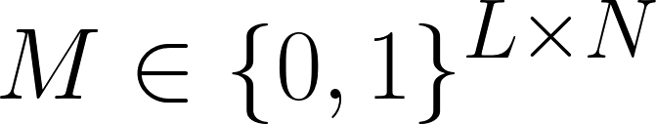
Algorithm AMPD: Deep Dive
Step 2: Build the Local Maxima Scalogram (LMS Matrix)
The LMS matrix records whether a sample 𝑥[𝑖] is a local maximum at scale k.
N: length of signal (N=11)
L=⌊ N/2​ ⌋ : number of scales (L=⌊11/2​⌋=5)
𝑀 [ 𝑘,𝑖 ] = 1 if:
x[i] > x[ i − k ] and x[ i ] > x [ i + k ]
esle 𝑀 [ 𝑘,𝑖 ] = 0
In easy words:
Is 𝑥 [ 𝑖 ] the biggest among its ±k
neighbors?
 | i=0 | i=1 | i=2 | i=3 | i=4 | i=5 | i=6 | i=7 | i=8 | i=9 | i=10
k=1 | 1.0 | 1.0 | 0.0 | 1.0 | 0.0 | 1.0 | 0.0 | 1.0 | 0.0 | 1.0 | 1.0
k=2 | 1.0 | 1.0 | 1.0 | 1.0 | 0.0 | 0.0 | 0.0 | 1.0 | 1.0 | 1.0 | 1.0
k=3 | 1.0 | 1.0 | 1.0 | 1.0 | 0.0 | 1.0 | 0.0 | 1.0 | 1.0 | 1.0 | 1.0
k=4 | 1.0 | 1.0 | 1.0 | 1.0 | 0.0 | 0.0 | 0.0 | 1.0 | 1.0 | 1.0 | 1.0

Slide 23
Algorithm AMPD: Deep Dive
Step 2: Build the Local Maxima Scalogram (LMS Matrix)
Index (i) | Detrended x[i]
0 | -0.682
1 | 0.322
2 | -0.475
3 | 1.329
4 | -0.567
5 | 0.436
6 | -0.660
7 | 0.844
8 | -0.353
9 | 0.451
10 | -0.645
 | i=0 | i=1 | i=2 | i=3 | i=4 | i=5 | i=6 | i=7 | i=8 | i=9 | i=10
k=1 | 1.0 | 1.0 | 0.0 | 1.0 | 0.0 | 1.0 | 0.0 | 1.0 | 0.0 | 1.0 | 1.0
k=2 | 1.0 | 1.0 | 1.0 | 1.0 | 0.0 | 0.0 | 0.0 | 1.0 | 1.0 | 1.0 | 1.0
k=3 | 1.0 | 1.0 | 1.0 | 1.0 | 0.0 | 1.0 | 0.0 | 1.0 | 1.0 | 1.0 | 1.0
k=4 | 1.0 | 1.0 | 1.0 | 1.0 | 0.0 | 0.0 | 0.0 | 1.0 | 1.0 | 1.0 | 1.0
k = 1
i = 1
x[1]=0.3218
x[0]=−0.6818
x[2]=−0.4745 True → M[1,1] = 1
i = 2
x[2]=−0.4745
x[1]=0.3218
x[3]=1.3291 False → M[1,2] = 0
k = 2
i = 2:
x[2]=−0.4745
x[0]=−0.6818
x[4]=−0.5673 True → M[2,2] = 1
i = 3:
x[3]=1.3291
x[1]=0.3218
x[5]=0.4364 True → M[2,3] = 1
k = 3
i = 2:
x[2]=−0.4745
x[0]=−0.6818
x[4]=−0.5673 True → M[2,2] = 1
i = 3:
x[3]=1.3291
x[1]=0.3218
x[5]=0.4364 True → M[2,3] = 1
If x[i] > x[ i − k ] and x[ i ] > x [ i + k ]:
𝑀 [ 𝑘,𝑖 ] = 1
Esle:
𝑀 [ 𝑘,𝑖 ] = 0

Slide 24
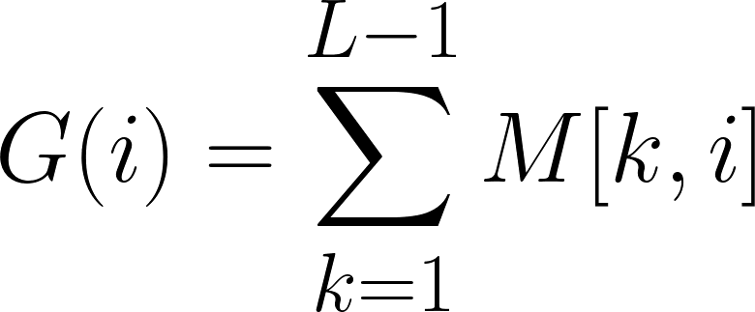
Algorithm AMPD: Deep Dive
Step 3: G(I) - Peak Support Scores
Index (i) | x_detrended | k=1 | k=2 | k=3 | k=4 | G(i) 1+2+3+4
0 | -0.6818 | 1.0 | 1.0 | 1.0 | 1.0 | 4
1 | 0.3218 | 1.0 | 1.0 | 1.0 | 1.0 | 4
2 | -0.4745 | 0.0 | 1.0 | 1.0 | 1.0 | 3
3 | 1.3291 | 1.0 | 1.0 | 1.0 | 1.0 | 4
4 | -0.5673 | 0.0 | 0.0 | 0.0 | 0.0 | 0
5 | 0.4364 | 1.0 | 0.0 | 1.0 | 0.0 | 2
6 | -0.6600 | 0.0 | 0.0 | 0.0 | 0.0 | 0
7 | 0.8436 | 1.0 | 1.0 | 1.0 | 1.0 | 4
8 | -0.3527 | 0.0 | 1.0 | 1.0 | 1.0 | 3
9 | 0.4509 | 1.0 | 1.0 | 1.0 | 1.0 | 4
10 | -0.6455 | 1.0 | 1.0 | 1.0 | 1.0 | 4
How many different scales say
that x[i] looks like a peak

Slide 25
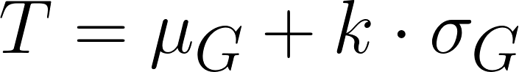
Algorithm AMPD: Deep Dive
Step 4: Detected Peaks Based On G(I)
threshold = int(0.95 * G.max())
= int(0.95 * 4)
= int(3.8)
= 3
default in paper is 95% of max G(i)
We can use :
1. Mean + k × Standard Deviation
2. Top-N G(i) Values
3. Elbow/Knee Method on Sorted G(i) (conceptual)
4. Otsu’s Method (Histogram-Based Thresholding)
from skimage.filters import threshold_otsu
T = threshold_otsu(G)
Index (i) | x_detrended | G(i) 1+2+3+4 | Threshold | PEAK
0 | -0.6818 | 4 | 3
1 | 0.3218 | 4 | 3
2 | -0.4745 | 3 | 3
3 | 1.3291 | 4 | 3
4 | -0.5673 | 0 | 3
5 | 0.4364 | 2 | 3
6 | -0.6600 | 0 | 3
7 | 0.8436 | 4 | 3
8 | -0.3527 | 3 | 3
9 | 0.4509 | 4 | 3
10 | -0.6455 | 4 | 3

Slide 26
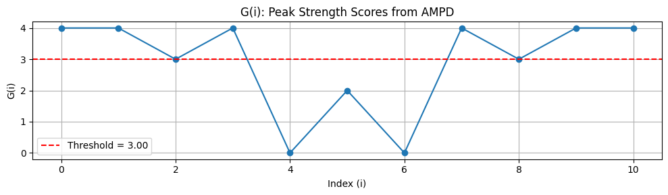
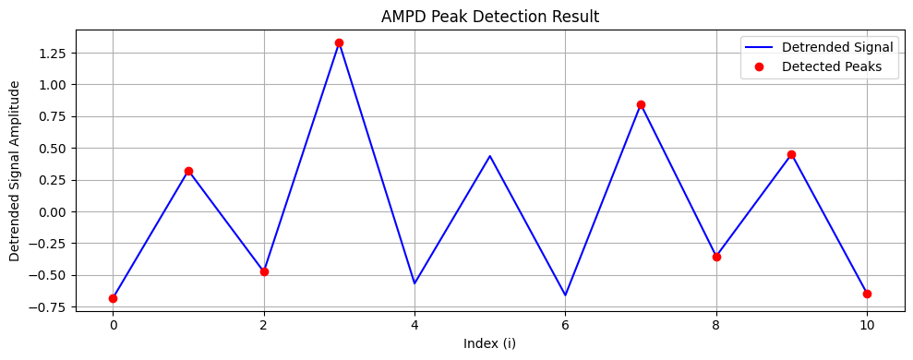
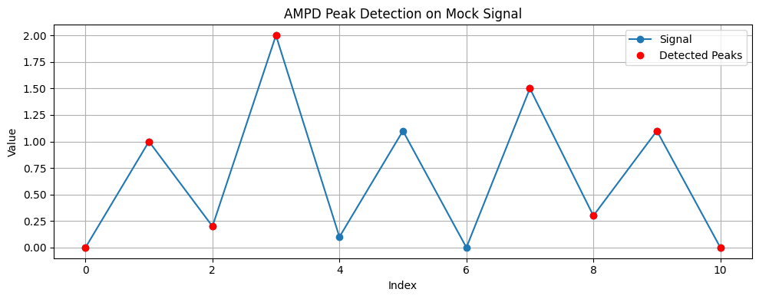
Algorithm AMPD: Deep Dive
Step 5: AMPD Peak Detection Result

Slide 27


Algorithm Flow Modified For HR Estimation
Extract RGB signals from face
Input Signal
AMPD
Raw Signal Green Channel/ICA
Detrend the Signal (Linear Detrending)
Calculate Local Maxima Scalogram (LMS)
Determine Optimal Scale λ
Reshape the LMS Matrix
Final Peak Detection by Stability

Slide 28


Algorithm Flow Modified For HR Estimation
Average Ground Truth HR: 106.70 bpm
Estimated HR from ICA Component 1:
Average HR: 1562.31 bpm
Number of peaks: 232
Mean RR interval: 0.223 s
Not
Human
Estimated HR from Green Channel:
Average HR: 1614.30 bpm
Number of peaks: 185
Mean RR interval: 0.280 s
RR intervals to a valid human range (0.4–1.5 sec)
60–100 bpm at rest
100–150 bpm for active/motion

Slide 29
Algorithm Flow Modified For HR Estimation
Extract RGB signals from face
Input Signal
AMPD
Raw Signal Green Channel/ICA
Detrend the Signal (Linear Detrending)
Calculate Local Maxima Scalogram (LMS)
Determine Optimal Scale λ
min_rr, max_rr = 0.4, 1.5
Reshape the LMS Matrix
Final Peak Detection by Stability

Slide 30


Algorithm Flow Modified For HR Estimation
Average Ground Truth HR: 106.70 bpm
Estimated HR from ICA Component 1:
Average HR: 110.07 bpm
Number of peaks: 12
Mean RR interval: 0.603 s
Estimated HR from Green Channel:
Average HR: 47.90 bpm
Number of peaks: 3
Mean RR interval: 1.267 s

Slide 31

Applied on UBFC
Sliding Window for Reducing the processing time.
Addin the ROI for specific part of the face.
Add some processing method for RGB Signals.

Slide 32






Sliding Windows For 5 Seconds (Green Channel)

Slide 33



Sliding Windows For 5 Seconds (Green Channel)

Slide 34






Sliding Windows For 5 Seconds (ICA)

Slide 35



Sliding Windows For 5 Seconds (ICA)

Slide 36
Modification And Other Algorithms
Sliding Window for Reducing the processing time.(within a 3–5 second window)
Normalization
Add some processing method for RGB Signals.
POS (Plane-Orthogonal-to-Skin) Fastest and most robust for real-time estimation.
Only uses linear operations on RGB.
Works with 3–5s window (as shown in original paper).
Assumes some motion-free or stabilized region.
CHROM
Strong in noisy environments.
Slightly more computation than POS.
Still works in 5s window.
Needs illumination consistency.
ICA Automation
Other Algorithms
Modified AMPD
Pan-Tompkins Algorithm
Envelope/Hilbert Detection

